Slide 1
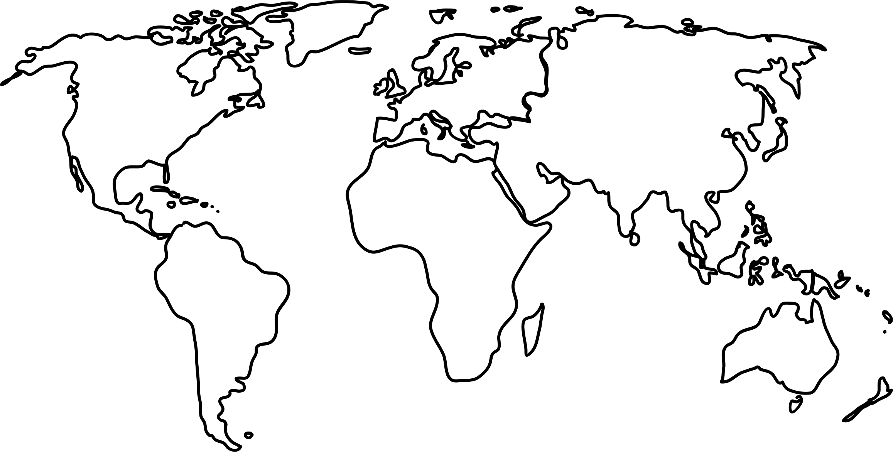
SoLR World Food Week 2023 Monday 16th October to Friday 20th October
Pick a day when colleagues are in the office and add it to your promotional posters
Ask colleagues to bring in a dish from around the world. Label ingredients and allergens
Place a donations bucket for people to donate to our chosen charity The Ocean Cleanup in return for a plate of food
Share food, stories, network and promote Land Referencing!
Find a space to host the event that is accessible for all
YOUR 2023 GUIDE
SoLR.org.uk

